Slide 1


Amazon Beauty Products Recommendation Engine
By:
Ms. Anupama
Ms. Laiba
Mr. Somanath
Ms. Jyoti
Ms. Sonal
Mr. Ashish

Slide 2
Business Objective
Amazon relies heavily on a Recommendation engine that reviews customer ratings and purchase history to recommend items and improve sales.
Content
This is a dataset related to over 2 Million customer reviews and ratings of Beauty related products sold on their website.
It contains
the unique UserId (Customer Identification),
the product ASIN (Amazon's unique product identification code for each product),
Ratings (ranging from 1-5 based on customer satisfaction) and
the Timestamp of the rating (in UNIX time)

Slide 3



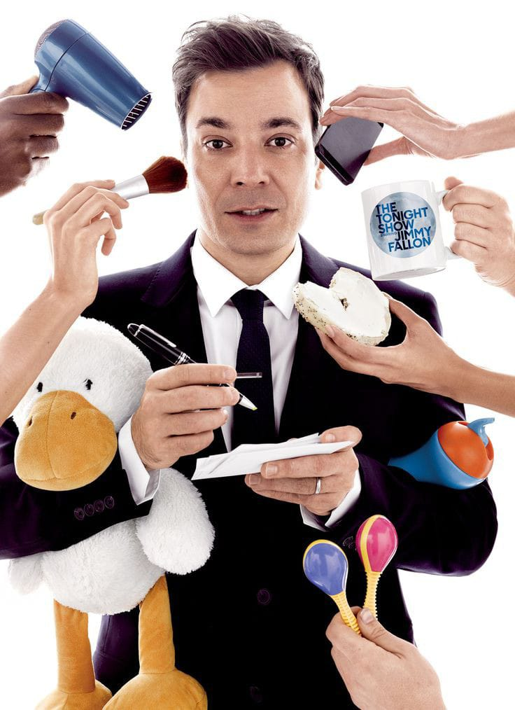



Beauty
Gender
Passion
Confidence
Profession
Colour
Race
Cast
Self Care

Slide 4
Project Architecture/Project Flow
Business Understanding
Data Collection
Data Preparation
Exploratory Data Analysis
Model Evaluation
Model Deployment

Slide 5
Data Collection
Web Scrapping
Segregation of Data
Match the values from given and scrapped data

Slide 6

Web Scrapping

Slide 7
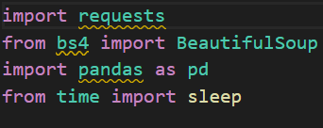
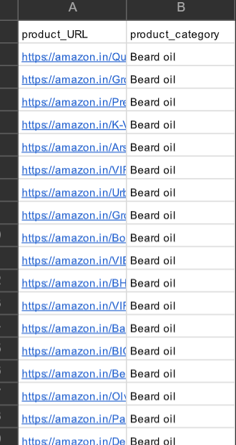
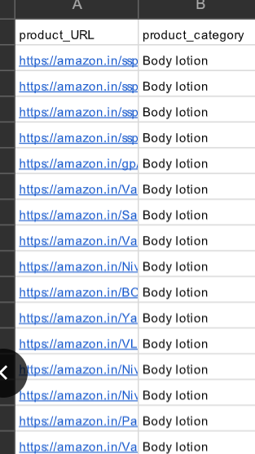
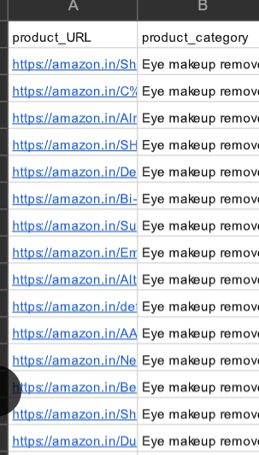
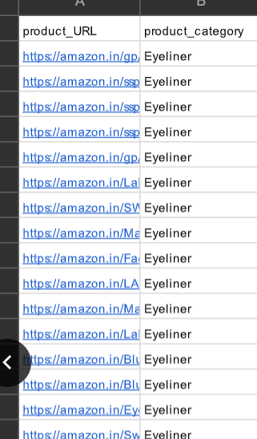
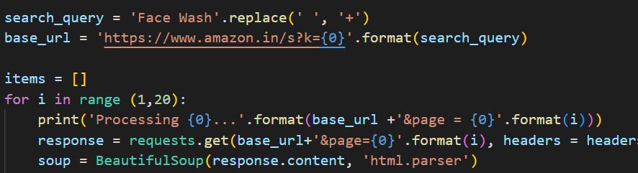
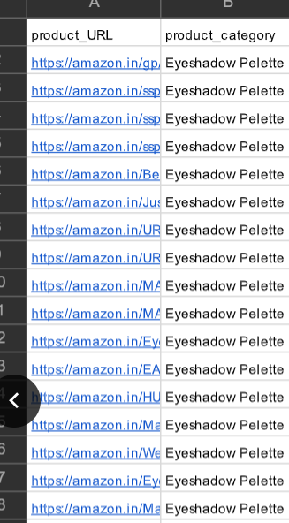
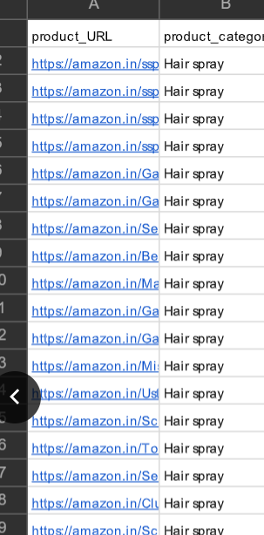

Slide 8

Data Filtering

Slide 9
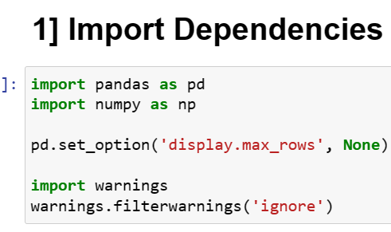
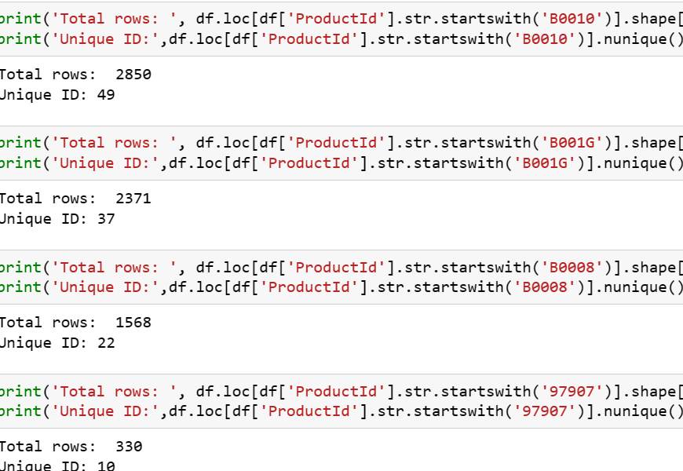
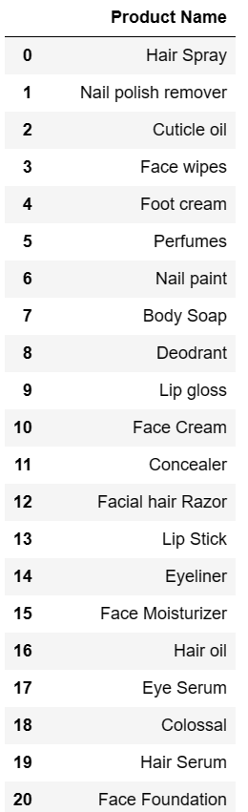
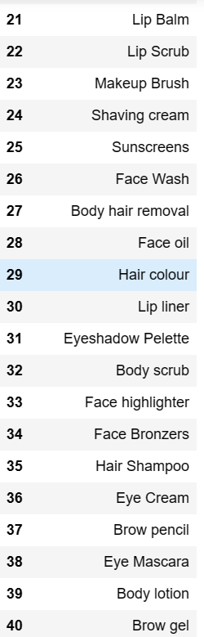
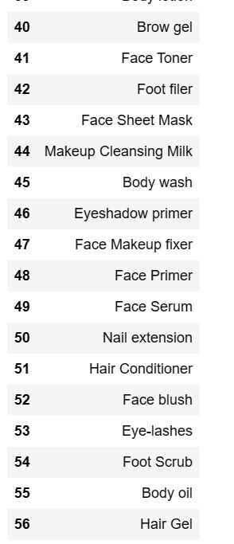
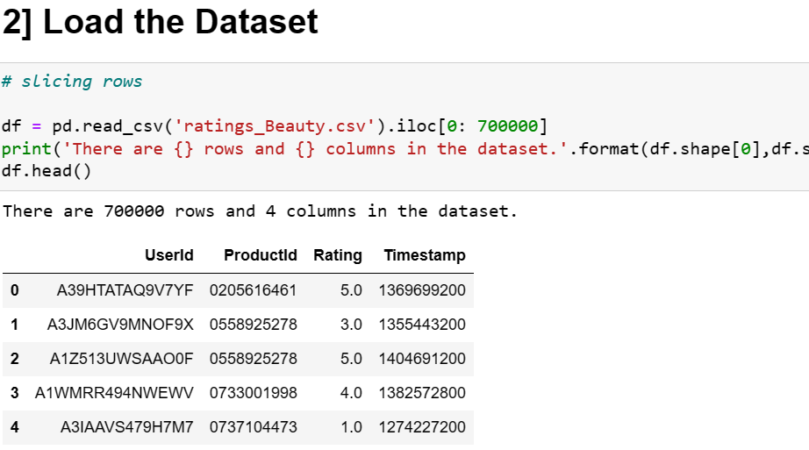
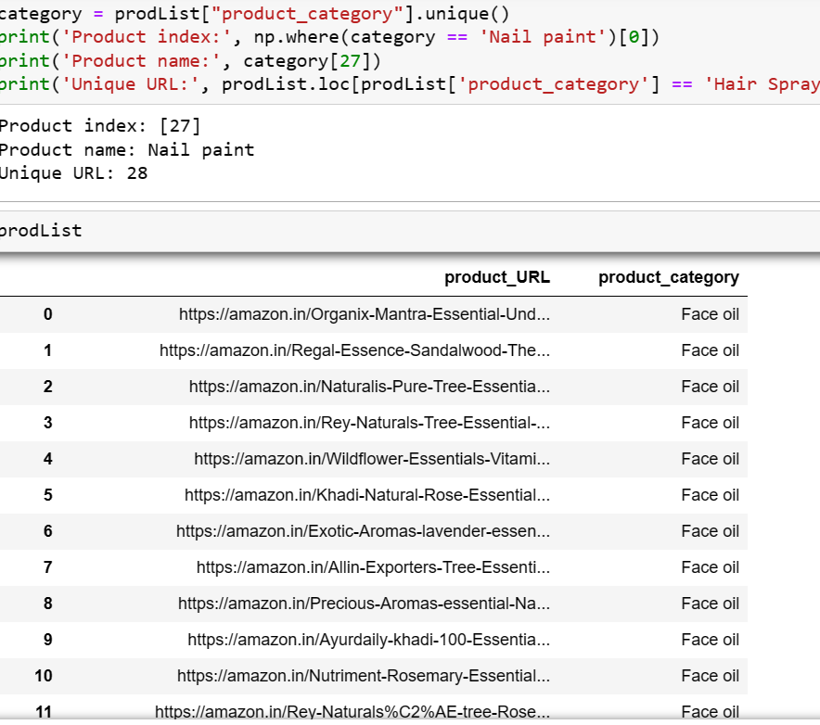
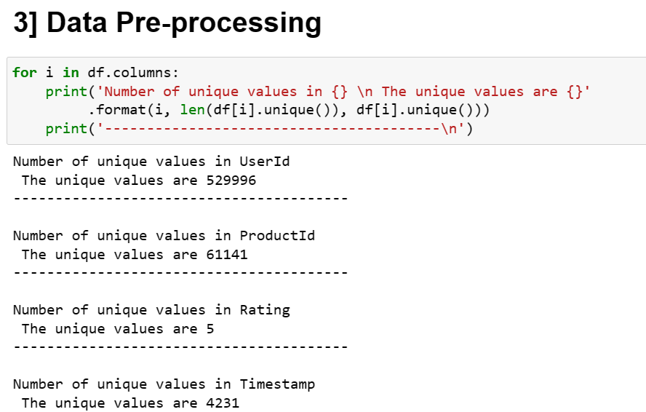
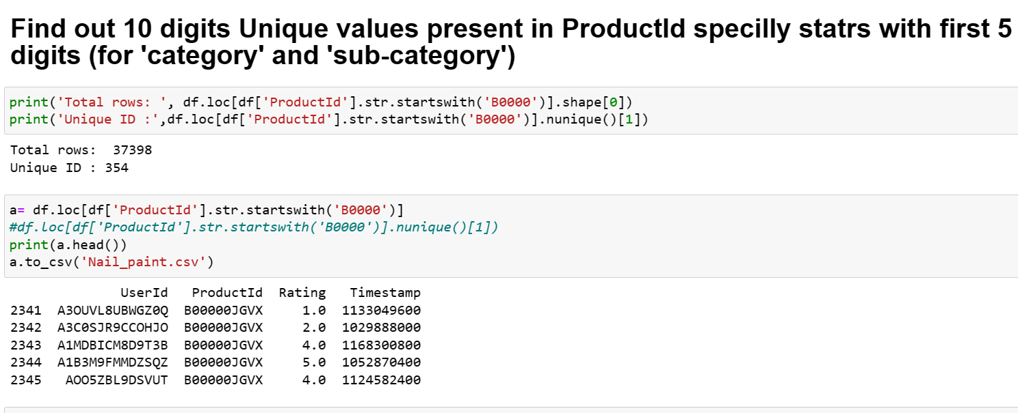

Slide 10

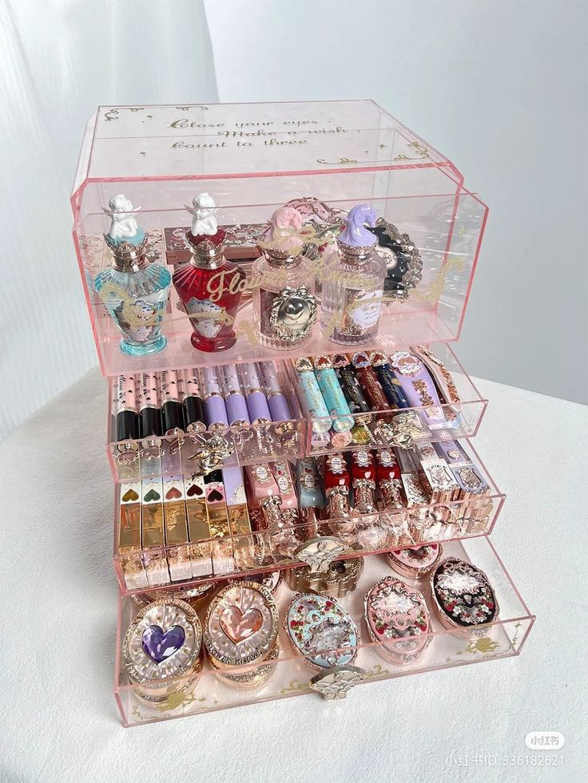


Slide 11

Final Data

Slide 12
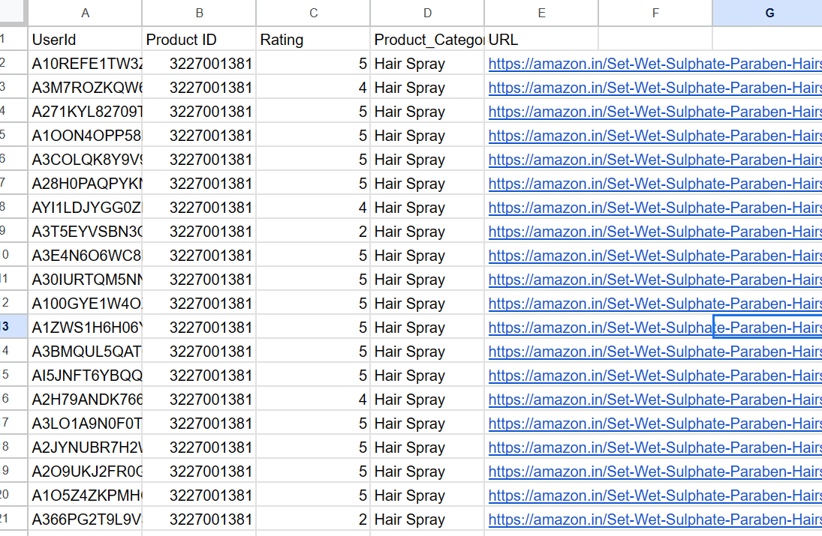

Slide 13


Exploratory Data Analysis

Slide 14
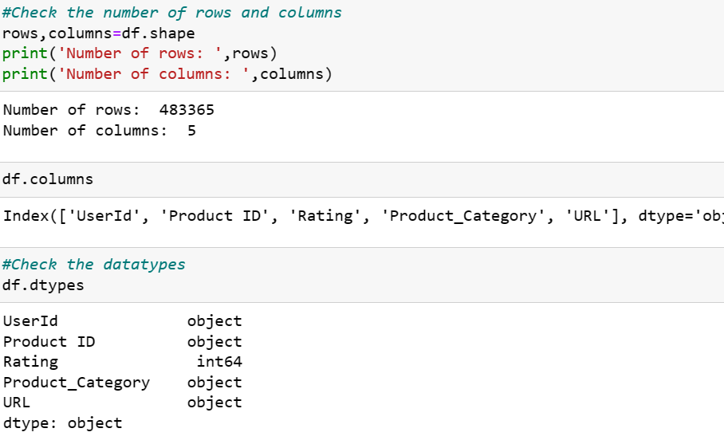
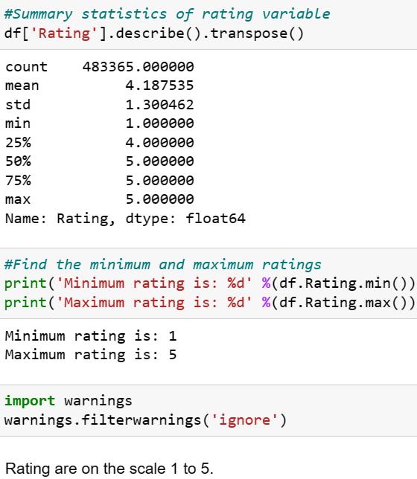
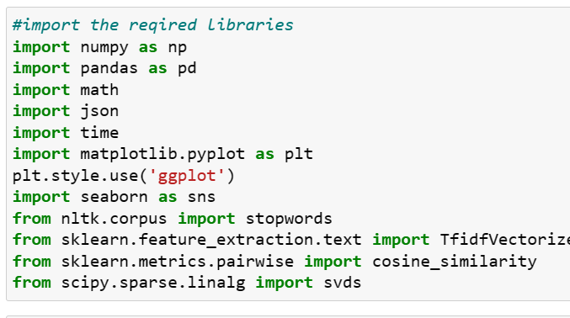
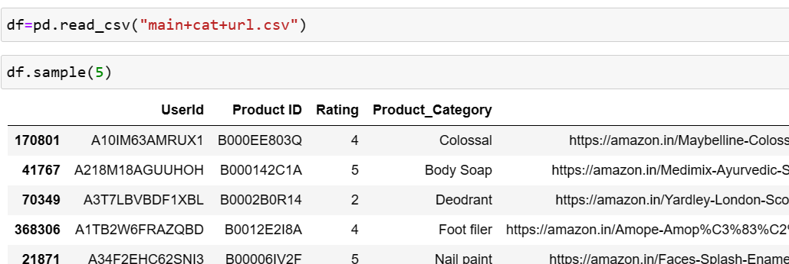
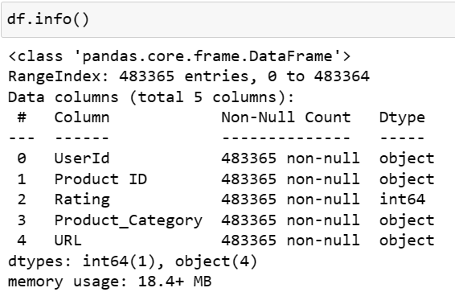
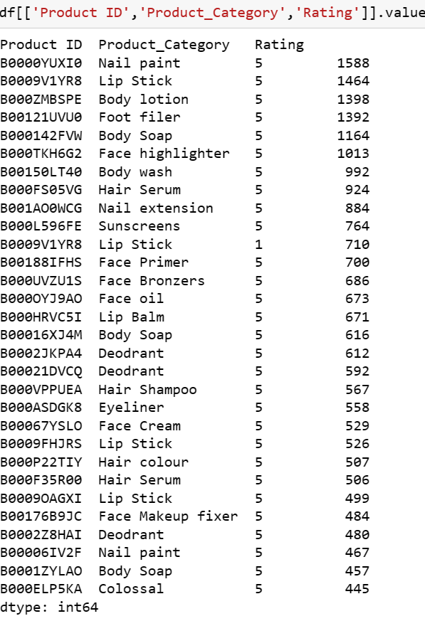
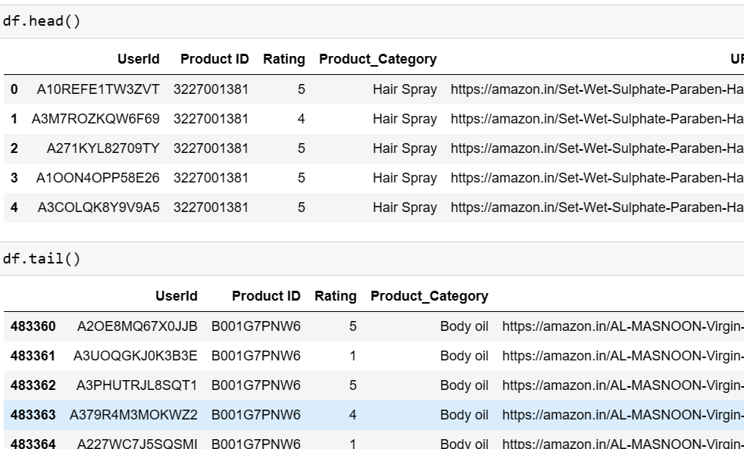
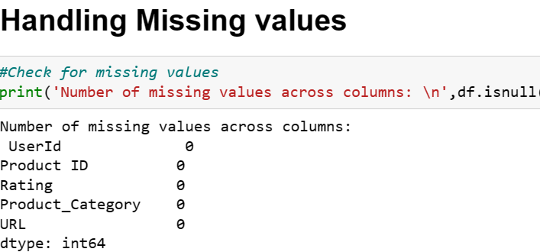

Slide 15

Data Visualization

Slide 16
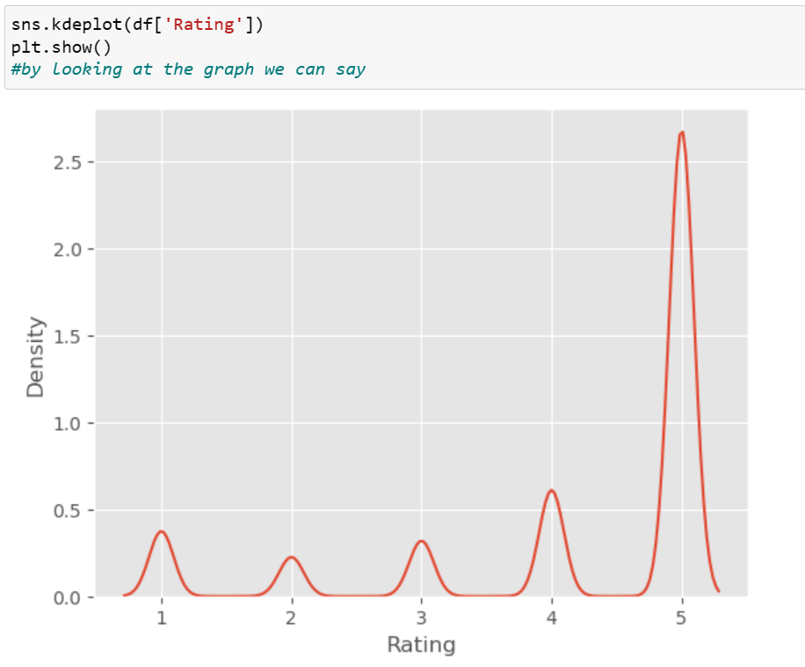
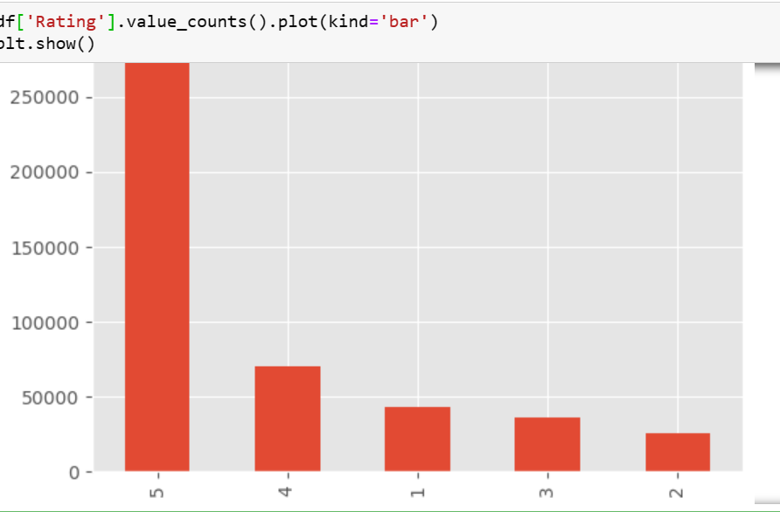
KDE Plot & Bar Plot

Slide 17
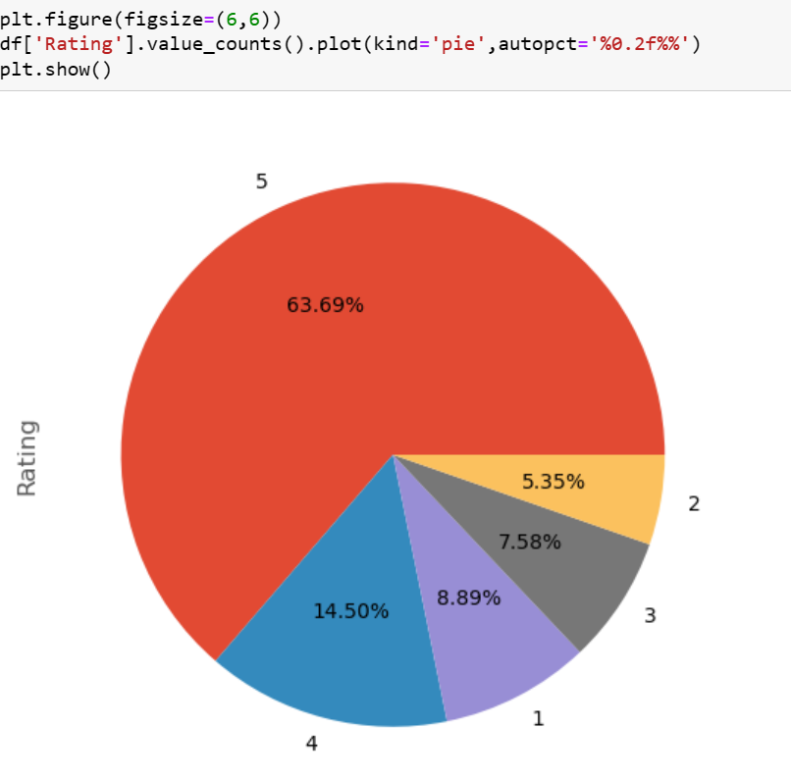
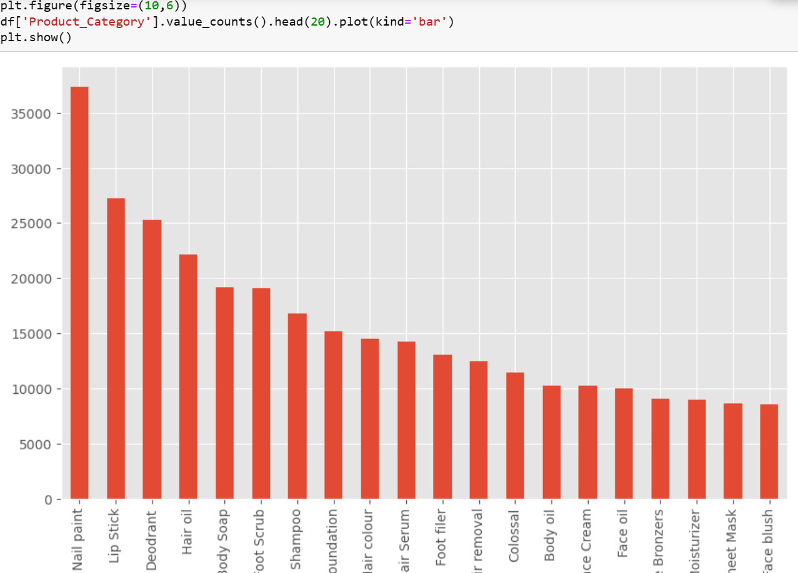
Pie Chart & Bar Chart

Slide 18
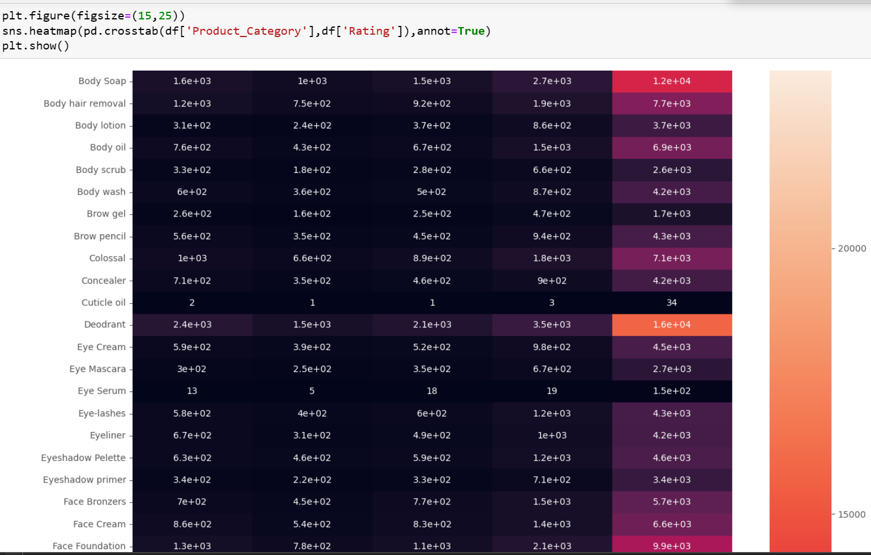
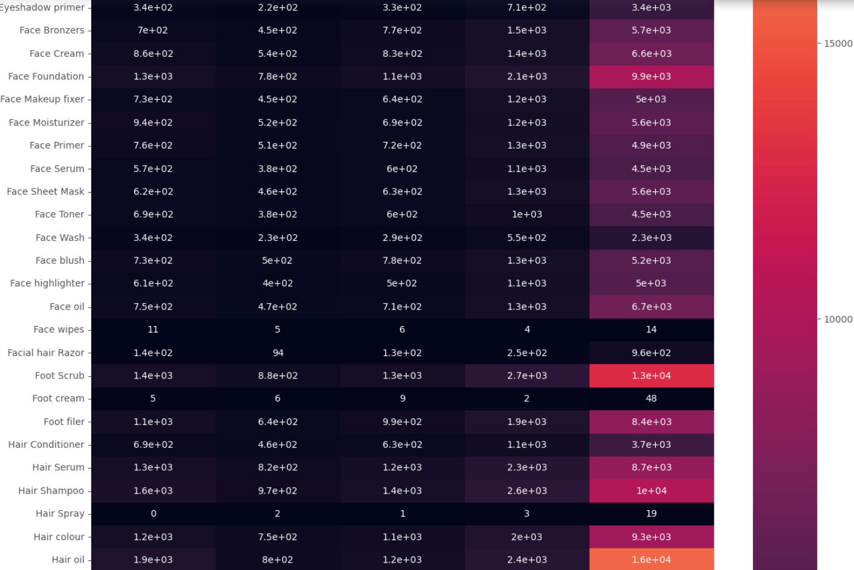
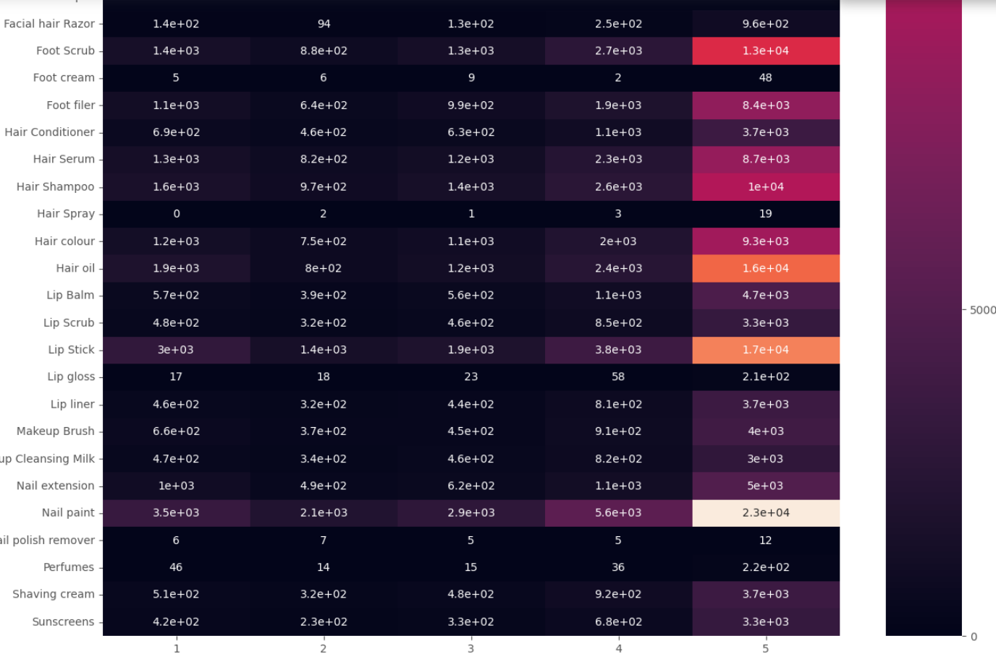

Slide 19
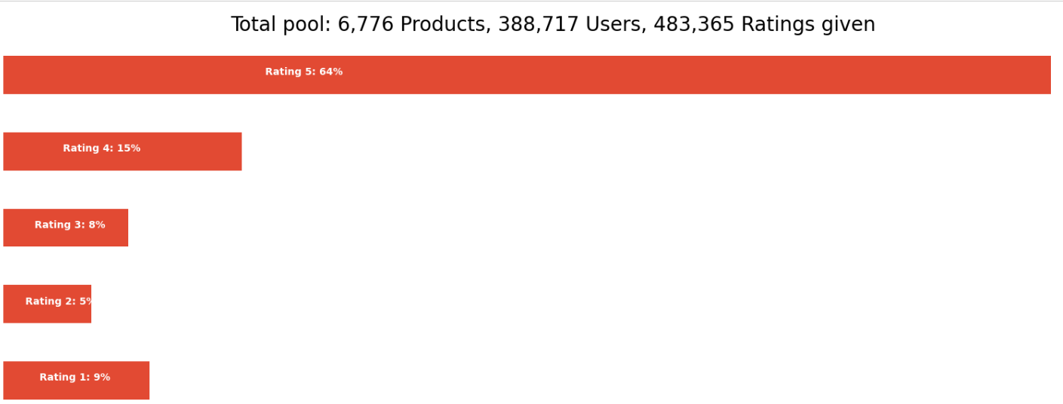
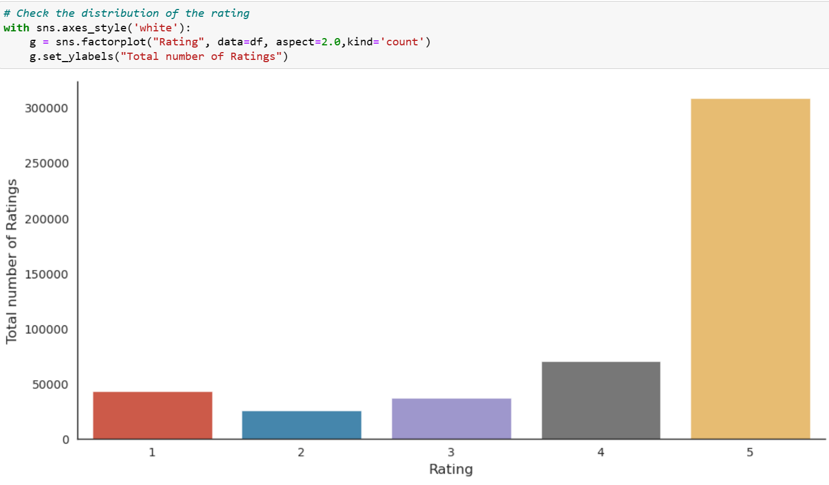
Ratings

Slide 20

Modelling

Slide 21
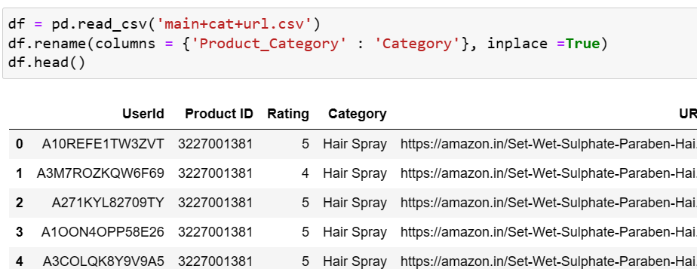
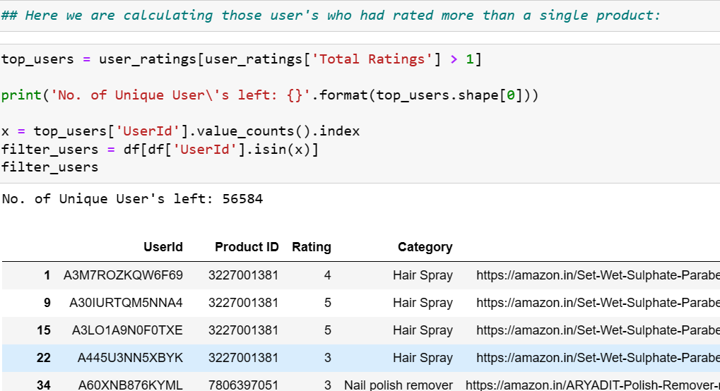
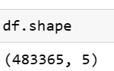
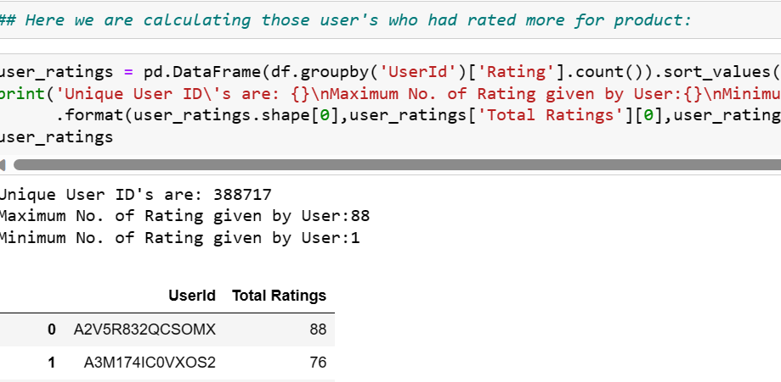
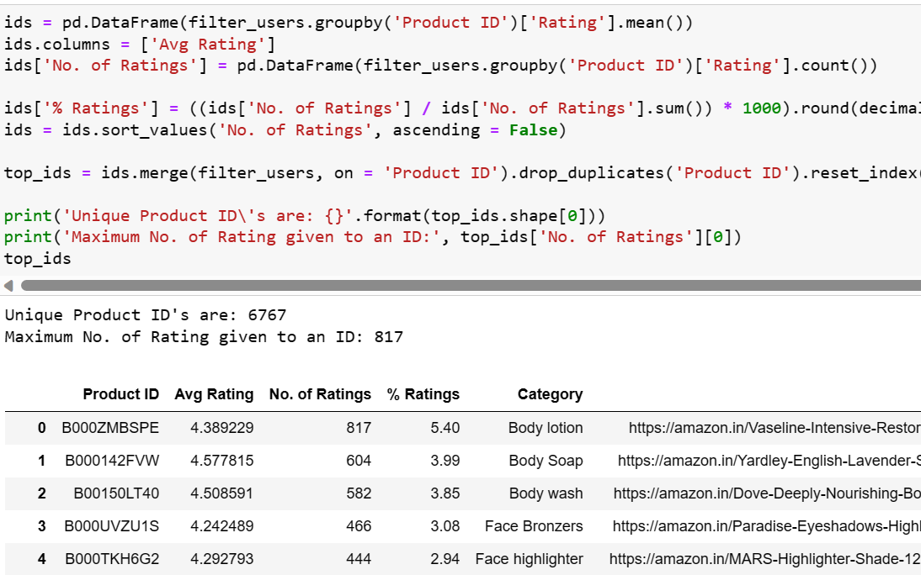

Slide 22
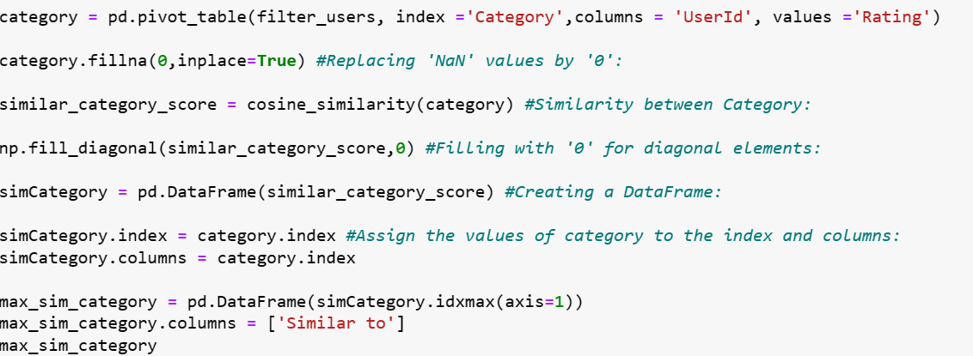
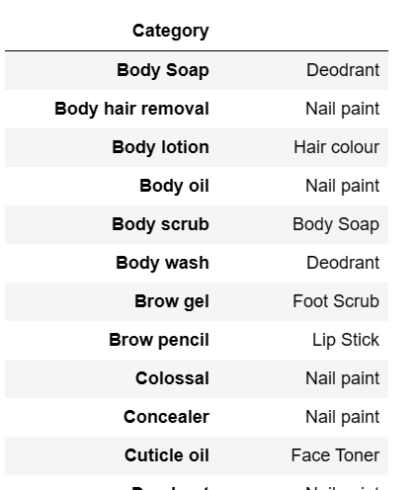
Category to category wise similarity

Slide 23
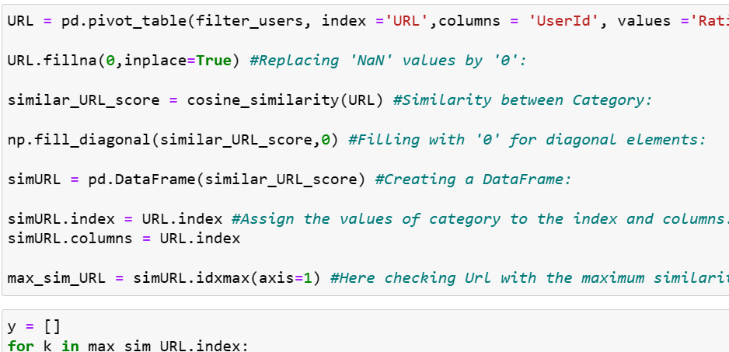
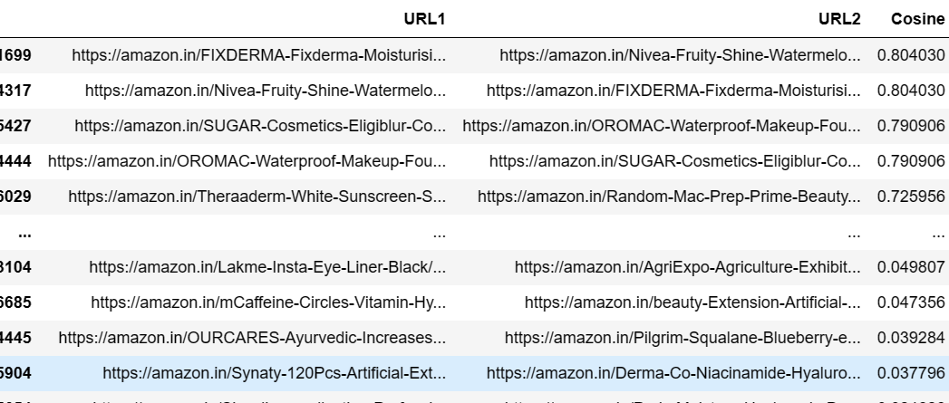
URL to URL Similarity

Slide 24

Model Testing

Slide 25
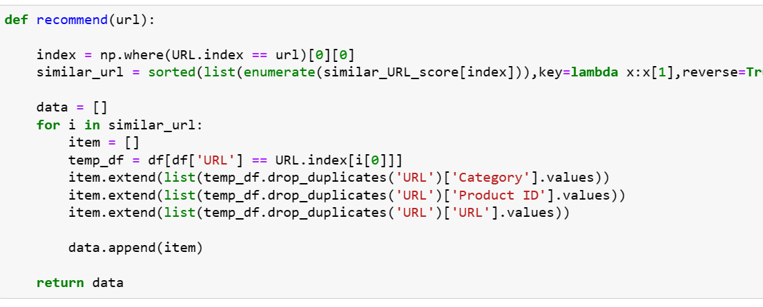
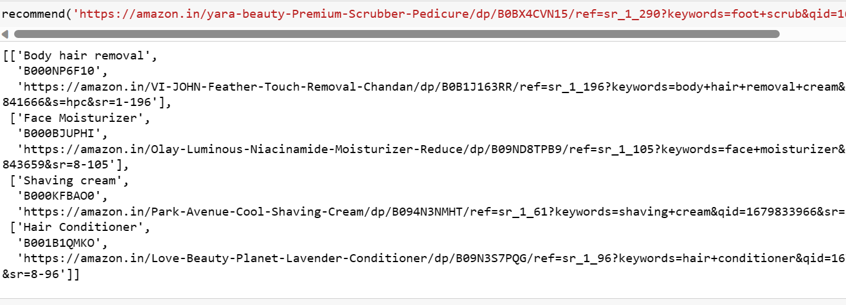
Model Testing

Slide 26

Deployment

Slide 27
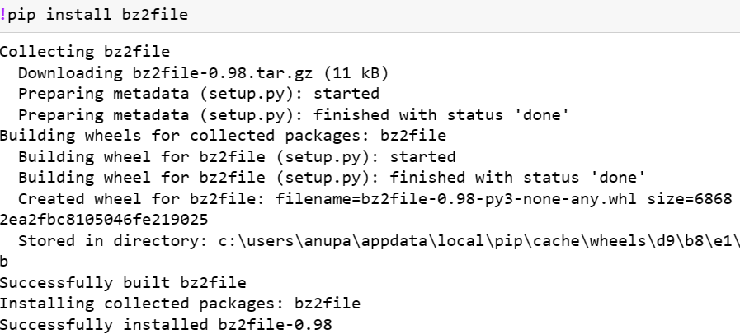
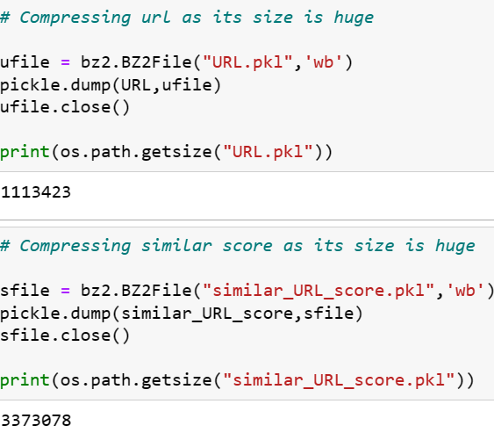

Deployment app front end development

Slide 28


Deployment Interface

Slide 29


Slide 30
Challenges faced
Research on history of Beauty Products ,types & prices
Deciding model building technique

Slide 31
How Challenges Overcome
As we are not much aware of the Beauty Products we have done a lot of research to find out the gold price history.
We as a team worked so hard to get the knowledge on the Amazon Recommendation and Beauty Products with their categories data.
Which helps us to do the project more effectively.

Slide 32
Deciding Model Building Technique
As we tried many model building techniques every model don’t have such a significant difference in the output
We are little bit worried about the output results that we got.
But we again overcame this as a team, Everyone has worked really hard on this part and we finally build a model that best suits the data

Slide 33



